Slide 1
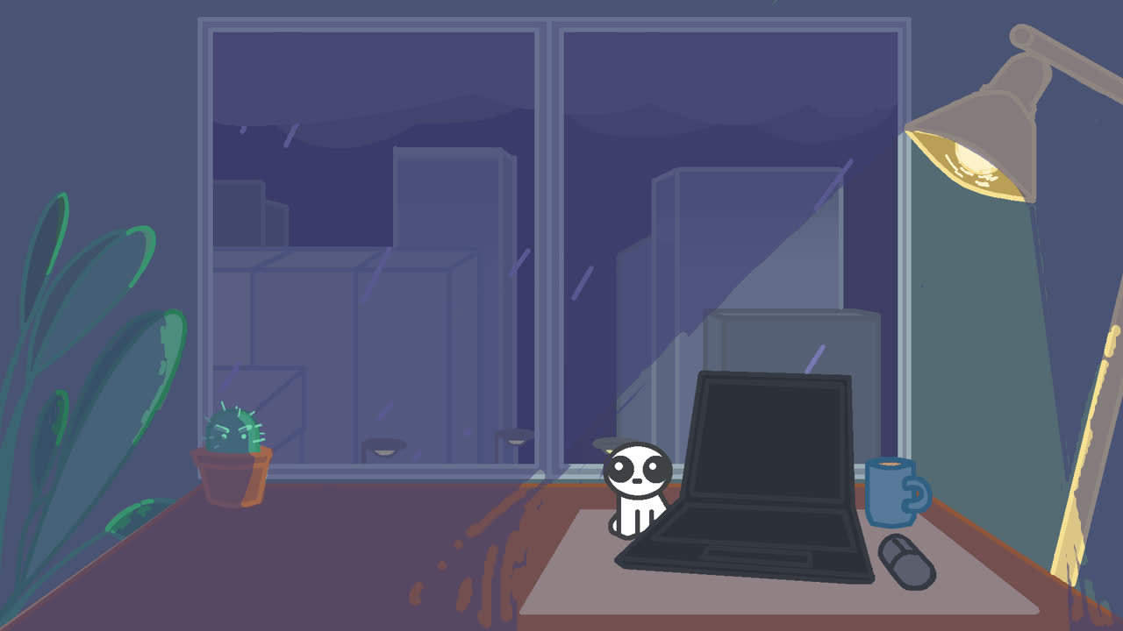
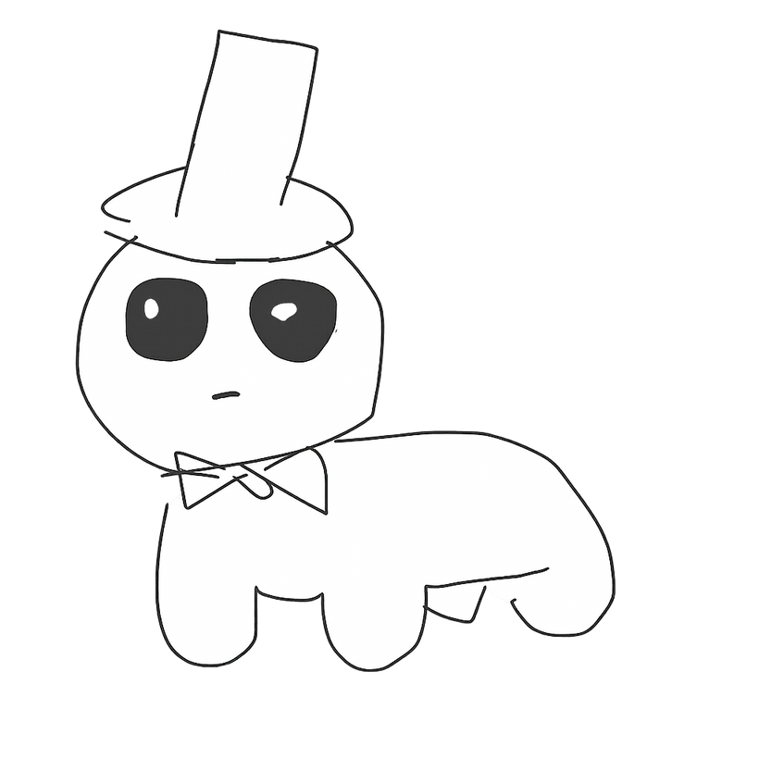
No packets

Slide 2
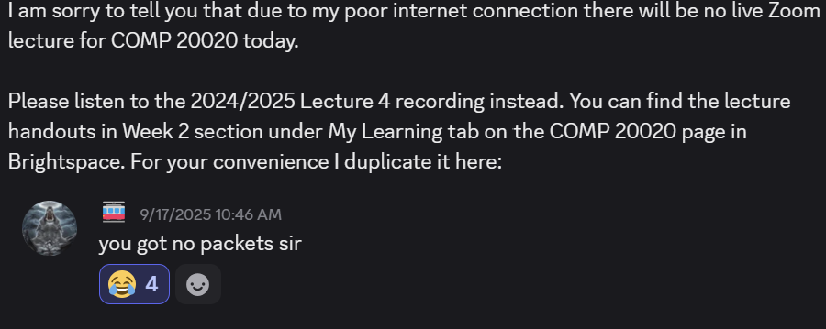

group history

Slide 3
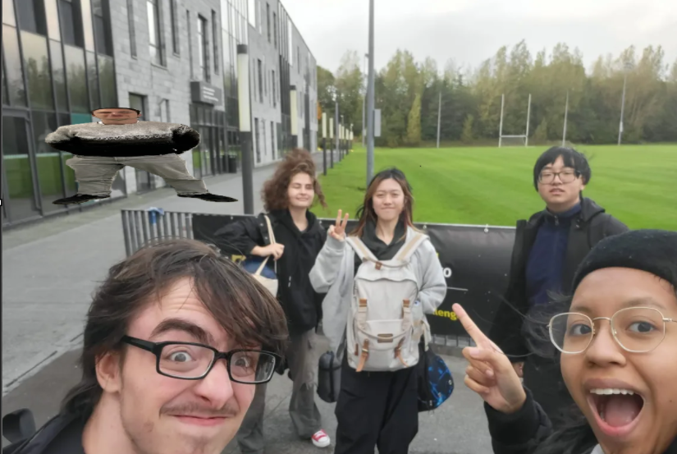
group history

Slide 4
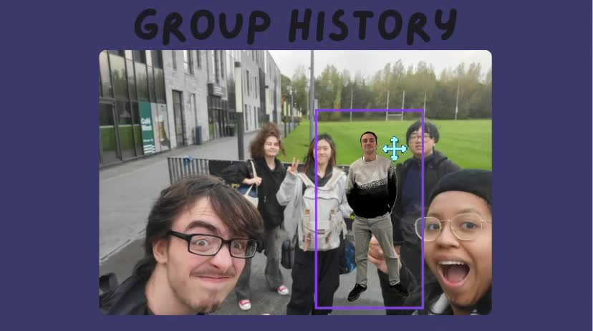

Slide 5
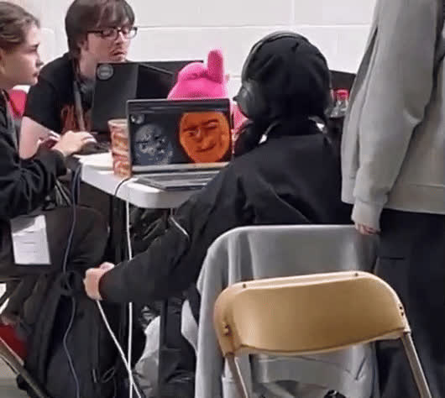
objective and roles
Our challenge was to create an app with a personalized interface that lets users conduct a query to return the likelihood of "very hot, cold, windy, wet or uncomfortable weather for the location and time they specify. ​ ​
We split our group into 2 for front end, 2 for backend, one for art, and one for DevOPs.​ ​
The front end was done by Kevin and Hailey.
Art was drawn by Ariel.​
DevOps was done by Christian​ Back end was done by Diana and Conor.​

Slide 6
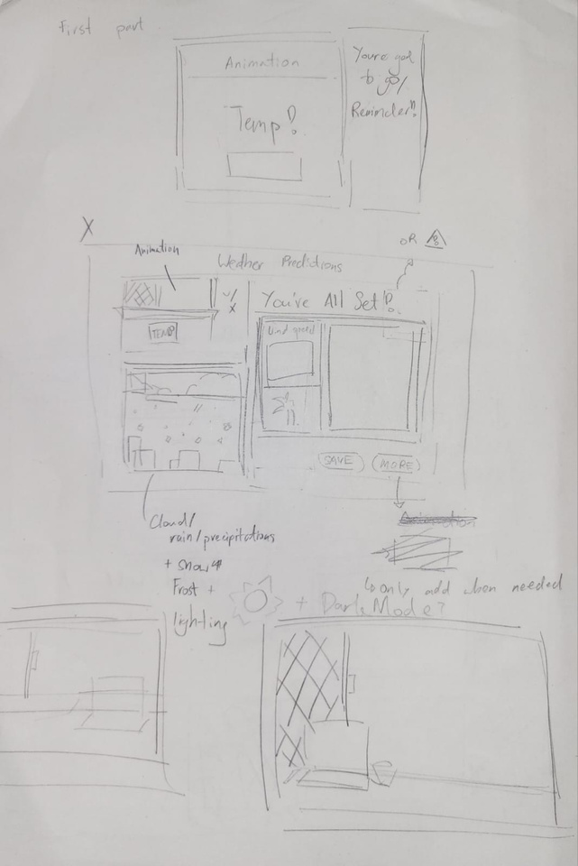
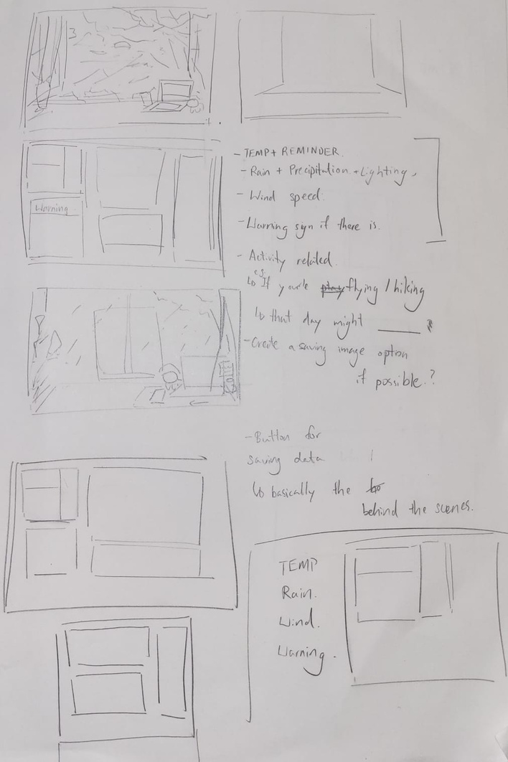


process

Slide 7
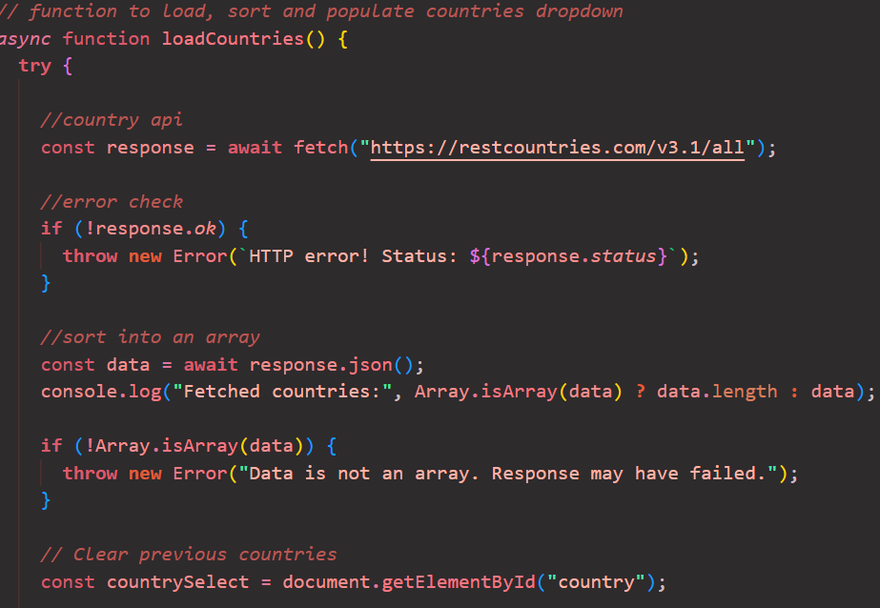
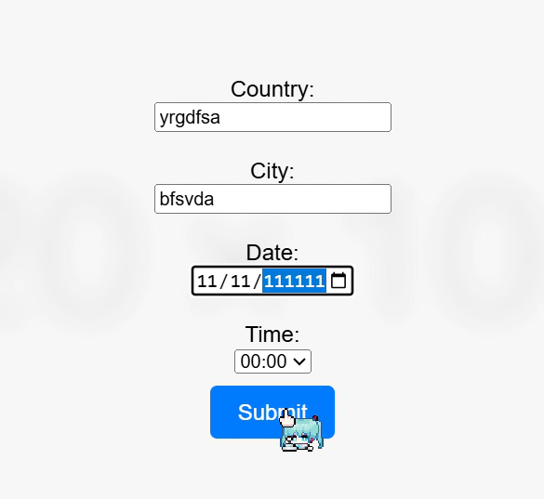
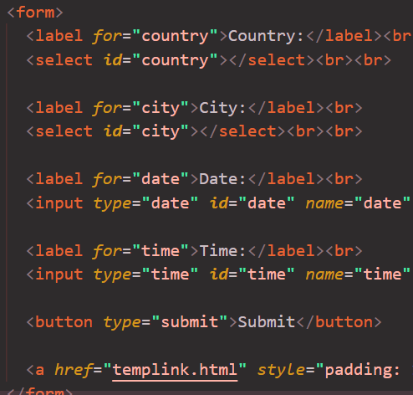
process

Slide 8
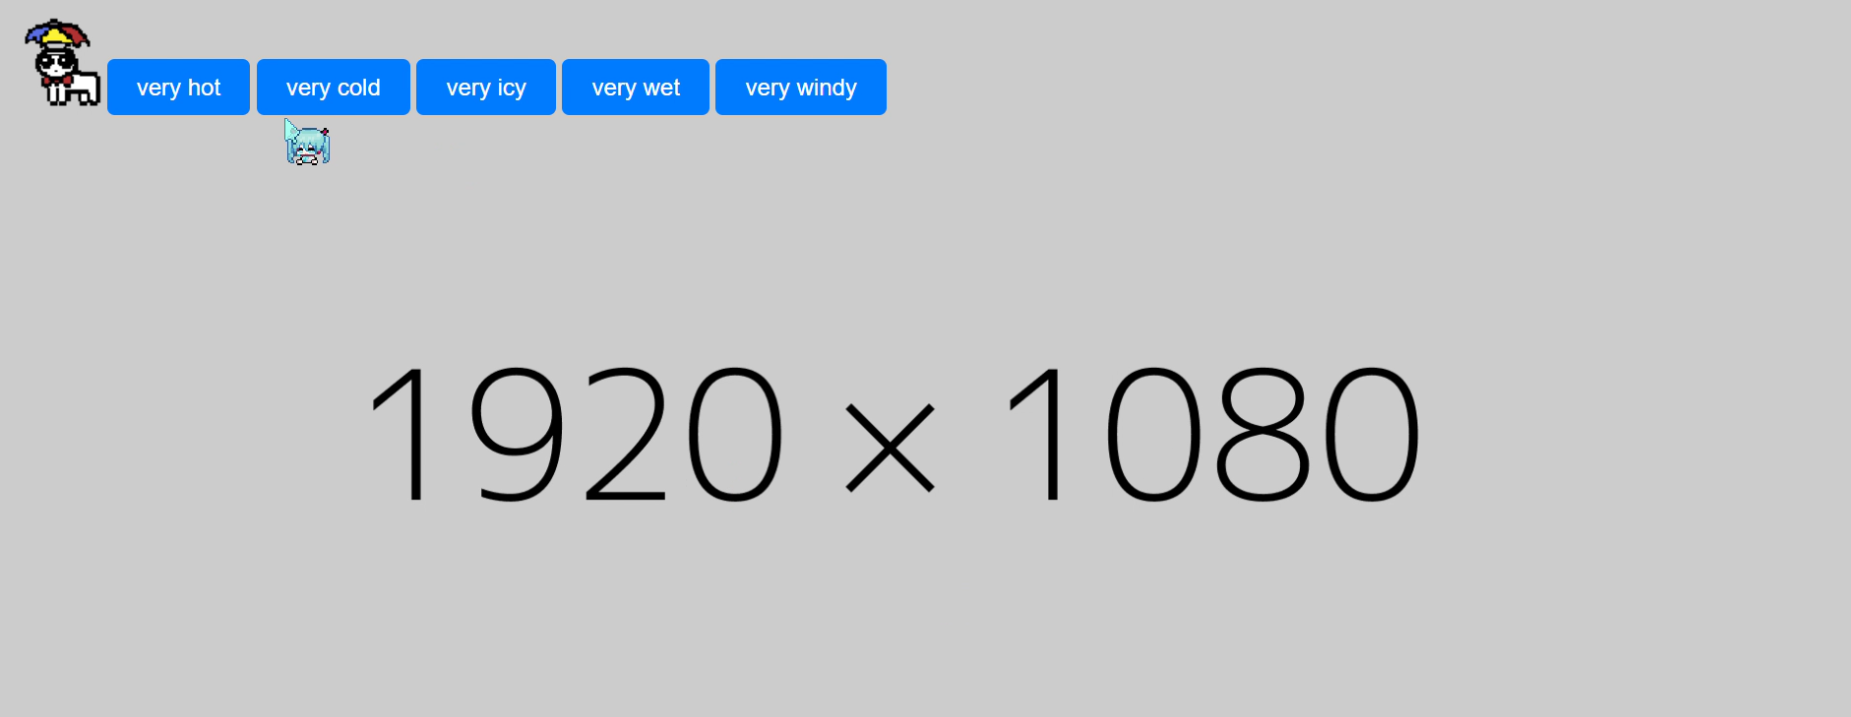
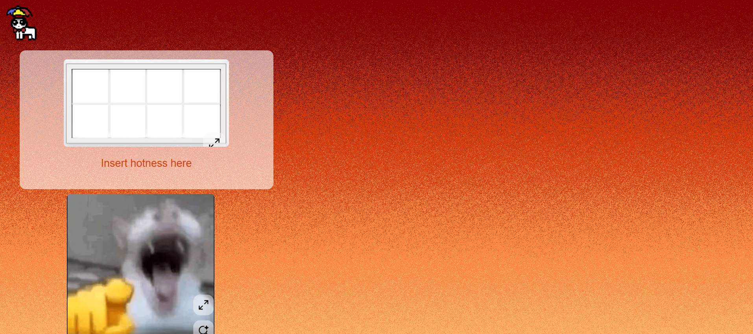
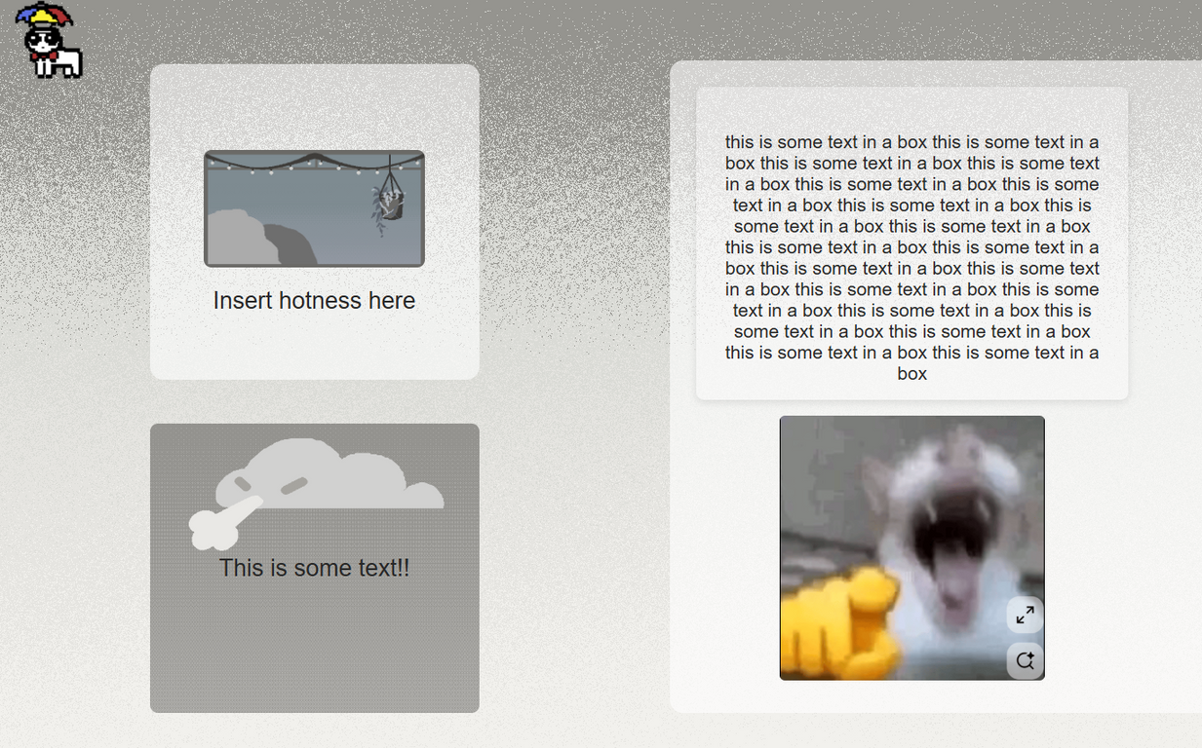
process

Slide 9
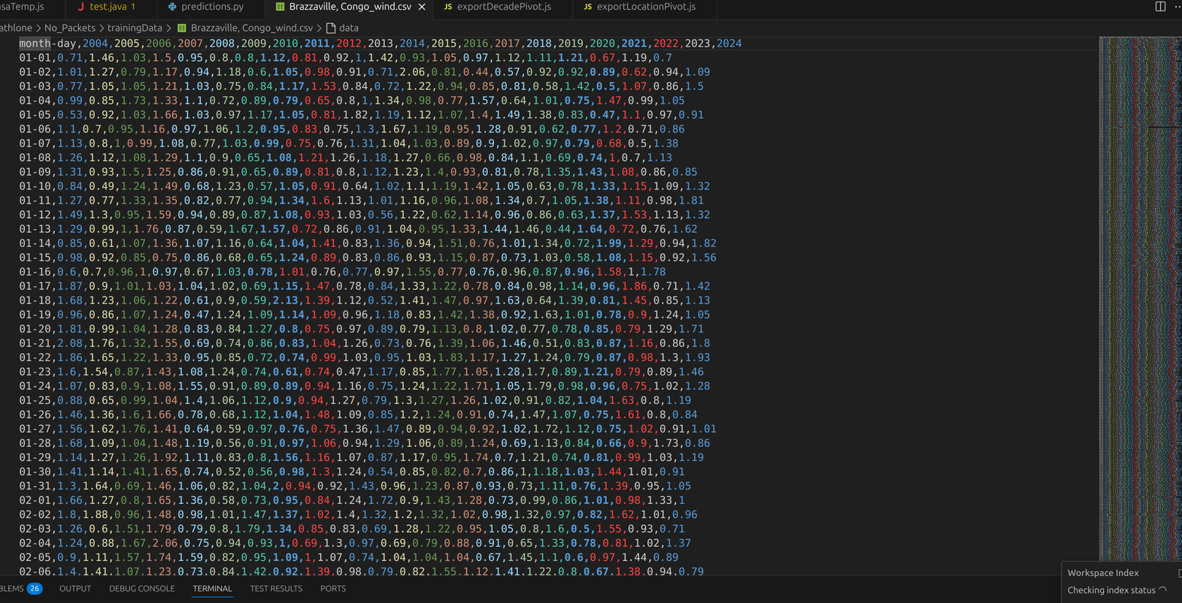
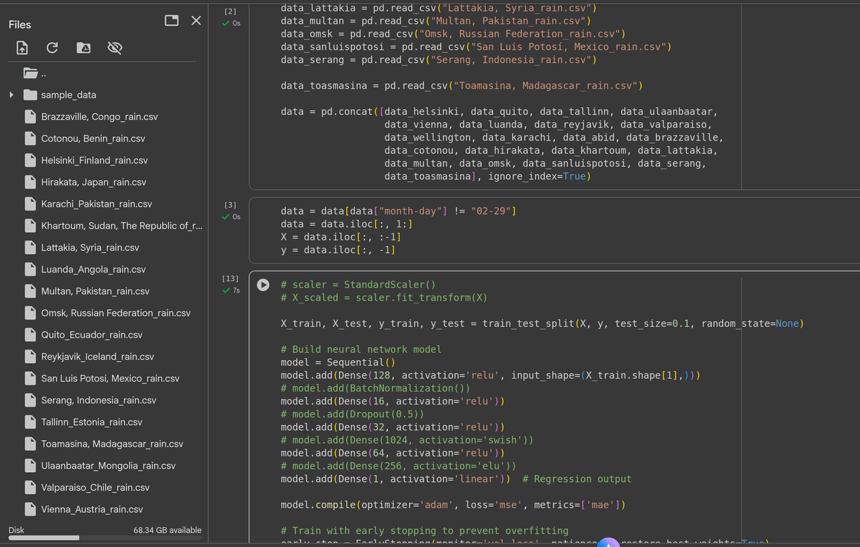
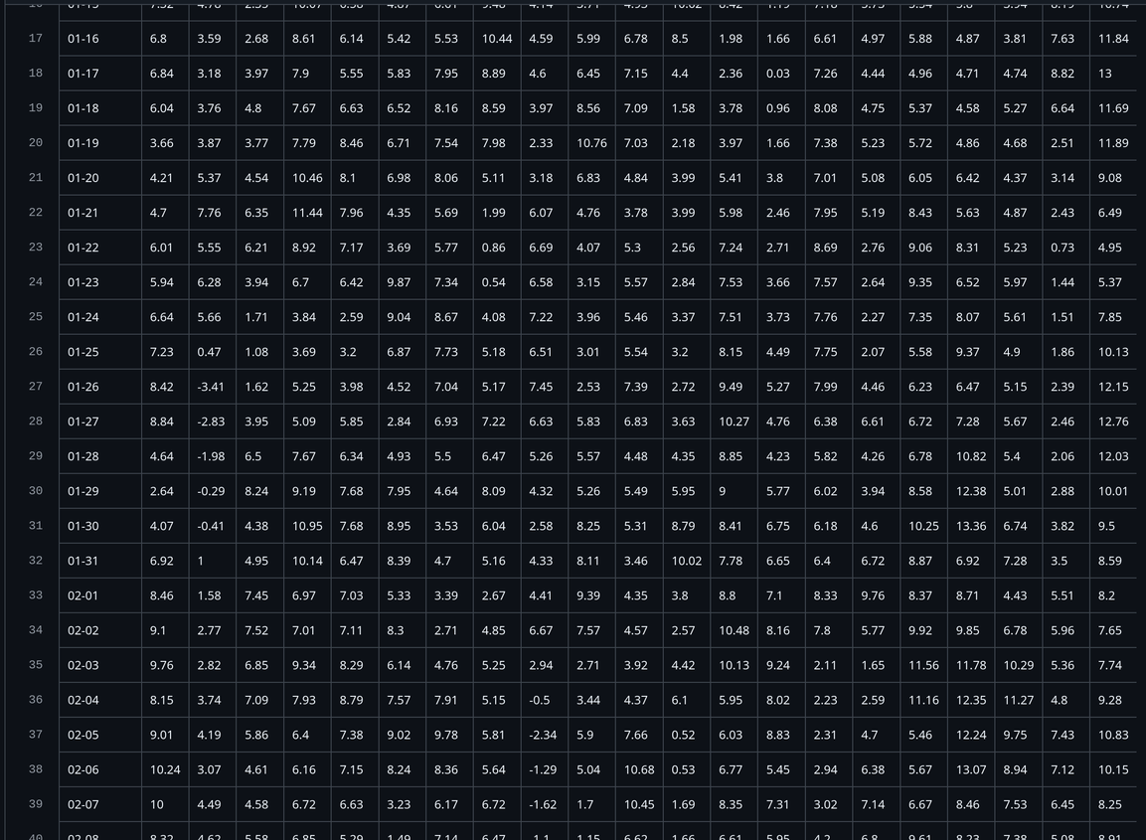
process

Slide 10
Any questions?

